Slide 1
SPRING AOP
September 8, 2016

Slide 2
AOP in Spring Framework
Cross-Cutting concerns
Need for AOP
AOP Basics
AOP Terminology
Custom Aspects Implementation
Problem Statement
@AspectJ based AOP
Advice Types
Defining Pointcut
Declaring Advice
Combining Pointcut expressions
Schema based AOP
Transaction management using AOP

Slide 3
Objectives
Understanding need for AOP
AOP implementation in Spring
AOP terminologies
@AspectJ based AOP
Schema based AOP
Transaction management using AOP

Slide 4
Spring Overview
Spring Framework is a Java platform that provides comprehensive infrastructure support for developing Java applications. Spring handles the infrastructure so you can focus on your application.
Spring enables you to build applications from "plain old Java objects" (POJOs) and to apply enterprise services non-invasively to POJOs.
Spring is designed to be non-intrusive, meaning that your domain logic code generally has no dependencies on the framework itself.
Key Features :
Lightweight framework
Modular
Dependency Injection
IOC container
Aspect Oriented

Slide 5
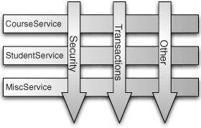
AOP in Spring Framework
One of the key components of Spring Framework is the Aspect oriented programming (AOP) framework.
Aspect Oriented Programming entails breaking down program logic into distinct parts called so-called concerns.
The functions that span multiple points of an application are called cross-cutting concerns and these cross-cutting concerns are conceptually separate from the application's business logic.
There are various common good examples of aspects like logging, auditing, declarative transactions, security, and caching etc.
The key unit of modularity in OOP is the class, whereas in AOP the unit of modularity is the aspect.
Dependency Injection helps you decouple your application objects from each other and AOP helps you decouple cross-cutting concerns from the objects that they affect.
Aspects in an application

Slide 6
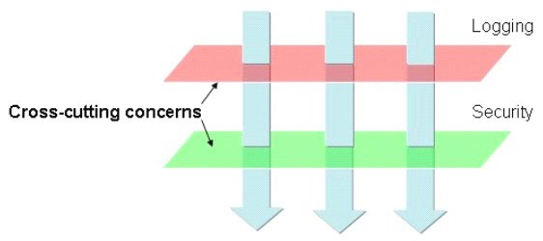
Cross-Cutting Concerns
Logging is a regular practice to keep eyes on events. In development phase, method starts logging messages. These log messages are helpful to reduce debugging time.
We can use logging APIs in our business methods to log the debug message but, logging is not the requirement of business method.
Typically, the concerns those are conceptually separate from (but often embedded directly within) the application’s business logic are called cross-cutting concerns.

Slide 7
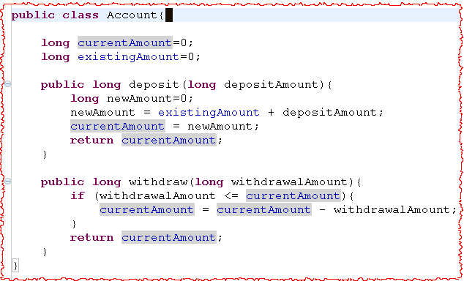
Need for AOP
Let’s analyze a non AOP code :
Notes:
The above code shows a simple Account Object that provides services for deposit and withdrawal operation in the form of Account.deposit() and Account.withdraw() methods.

Slide 8
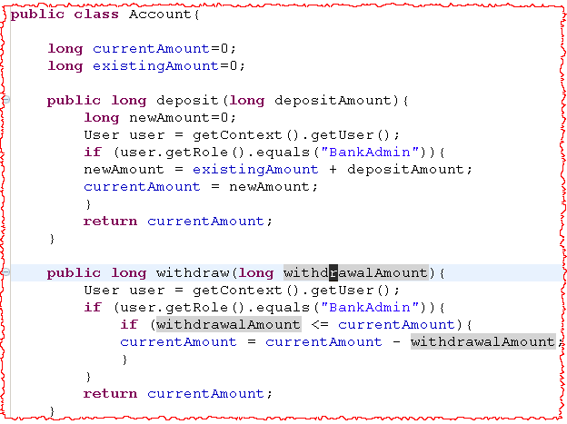
Need for AOP contd…
Adding Security to Account :
Notes:
Suppose say we want to add some bit of the security to the Account class, telling that only users with BankAdmin privilege is allowed to do the operations.

Slide 9
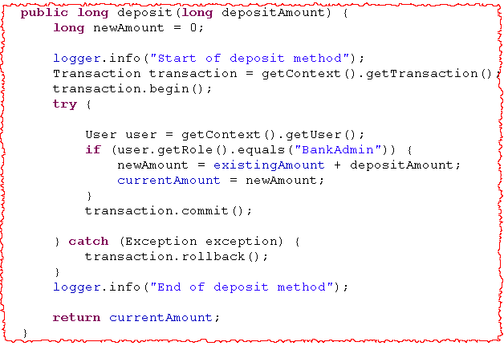
Need for AOP contd…
Adding logging and transaction to Account :
Notes:
Assume that another requirement for the above Account class is to provide some kind of Logging and Transaction Management Facility.

Slide 10
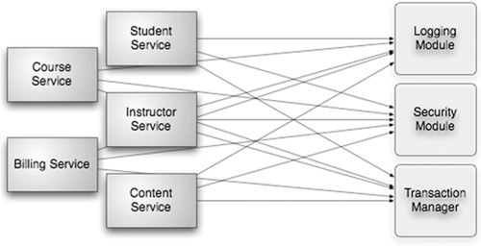
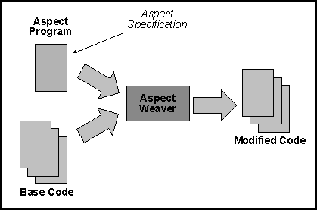
Need for AOP contd…
Non-AOP approach
By spreading these concerns across multiple components, two levels of complexity is introduce in the code –
Code duplication.
Introducing non-core functionality in core functionality.
AOP approach
Crosscutting concerns are separated from the functional logic and weaving is done to apply those functionality.

Slide 11
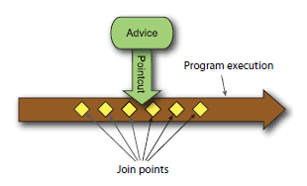
AOP Basics
In aspect oriented programming, cross – cutting concerns are not added to the business methods.
Cross – cutting concerns are defined in separate code and introduced to the business method by altering the byte code or generating run time classes.
Like most technologies, AOP has formed its own jargon. Aspects are often described in terms of advice, pointcuts, and join points.
Advice
An Advice defines both – what and when of an aspect.
For example, checking the security (what) before starting fund transfer (when) is an advice to transfer fund method.
Send a mail (what) to sender and recipient after the fund transfer (when) is an another advice to transfer fund method.

Slide 12
AOP Basics contd…
Join-Point
Your application may have thousands of opportunities for advice to be applied. These opportunities are known as join points. A join point is a point in the execution of the application where an aspect can be plugged in.
A security checking advice can be applied to the transfer fund method. In this statement, transfer fund method is a join-point.
Point-cut
Your application can have any number of join-points and any number of advices. All advices are not applied to all the join-points. A point-cut is a logical grouping of join-points. An advice is applied to a subset of point-cuts.

Slide 13
AOP Basics contd…
Aspect (Advisor)
An aspect is a combination of advise and point-cut.
Taken together, advice and point- cuts define everything there is to know about an aspect—what it does and where and when it does it.
Weaving
Weaving is the process of applying aspects to a target object to create a new proxy object. The aspects are woven into the target object at the specified join points.
Notes:
The weaving can take place at several points in the target object’s lifetime:
Compile time—Aspects are woven in when the target class is compiled. This requires a special compiler. AspectJ’s weaving compiler weaves aspects this way.
Classload time—Aspects are woven in when the target class is loaded into the JVM. This requires a special ClassLoader that enhances that target class’s byte- code before the class is introduced into the application. AspectJ 5’s load-time weaving (LTW) support weaves aspects in this way.
Runtime—Aspects are woven in sometime during the execution of the applica- tion. Typically, an AOP container will dynamically generate a proxy object that will delegate to the target object while weaving in the aspects. This is how Spring AOP aspects are woven.

Slide 14
AOP Terminologies
Terms | Description
Aspect | A module which has a set of APIs providing cross-cutting requirements. For example, a logging module would be called AOP aspect for logging. An application can have any number of aspects depending on the requirement.
Join point | This represents a point in your application where you can plug-in AOP aspect. You can also say, it is the actual place in the application where an action will be taken using Spring AOP framework.
Advice | This is the actual action to be taken either before or after the method execution. This is actual piece of code that is invoked during program execution by Spring AOP framework.
Pointcut | This is a set of one or more joinpoints where an advice should be executed. You can specify pointcuts using expressions or patterns as we will see in our AOP examples.
Introduction | An introduction allows you to add new methods or attributes to existing classes.
Target object | The object being advised by one or more aspects, this object will always be a proxied object. Also referred to as the advised object.
Weaving | Weaving is the process of linking aspects with other application types or objects to create an advised object. This can be done at compile time, load time, or at runtime.
Notes:
The weaving can take place at several points in the target object’s lifetime:
Compile time—Aspects are woven in when the target class is compiled. This requires a special compiler. AspectJ’s weaving compiler weaves aspects this way.
Classload time—Aspects are woven in when the target class is loaded into the JVM. This requires a special ClassLoader that enhances that target class’s byte- code before the class is introduced into the application. AspectJ 5’s load-time weaving (LTW) support weaves aspects in this way.
Runtime—Aspects are woven in sometime during the execution of the applica- tion. Typically, an AOP container will dynamically generate a proxy object that will delegate to the target object while weaving in the aspects. This is how Spring AOP aspects are woven.

Slide 15
Custom Aspects Implementation
Spring supports the @AspectJ annotation style approach and the schema-based approach to implement custom aspects :
XML Schema based : Aspects are implemented using regular classes along with XML based configuration.
@AspectJ based : @AspectJ refers to a style of declaring aspects as regular Java classes annotated with Java 5 annotations.

Slide 16

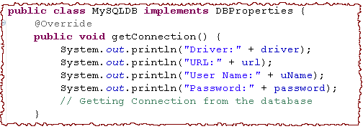
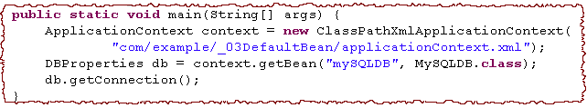

Problem Statement
Let us have a look on below code snippets
We want to print the
“Connecting the database” before executing getConnection() method.
“Connected to database” after execution of getConnected method
“Exception in DB Connection” in case of exception.
OUTPUT

Slide 17
@AspectJ based AOP
@AspectJ refers to a style of declaring aspects as regular Java classes annotated with Java 5 annotations.
The @AspectJ support is enabled by including the following element inside your XML Schema-based configuration file :
You will also need following AspectJ libraries on the classpath of your application. These libraries are available in the 'lib' directory of an AspectJ installation, otherwise you can download them from the internet :
aspectjrt.jar
aspectjweaver.jar
aspectj.jar
aopalliance.jar
<aop: aspectj-autoproxy/>

Slide 18
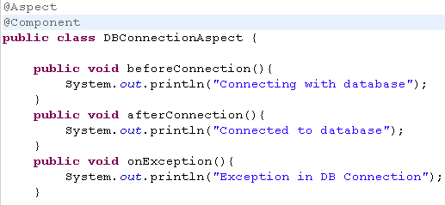
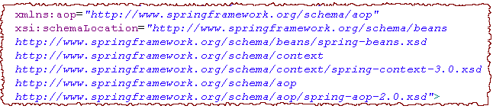
@AspectJ based AOP contd…
Step 1: Create an Aspect class for DB Connection
Stereotype bean to create the aspect
Method After Advice
Method Before Advice
Method throwing Exception Advice
Step 2: Add aop namespace to Configuration File

Slide 19
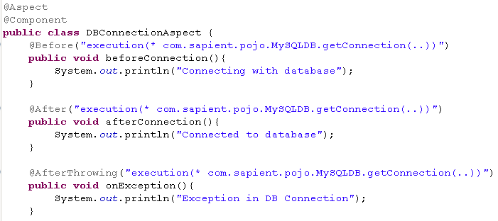

@AspectJ based AOP contd…
Step 3: Change in Aspect
Before Advice
Location where this aspect will be applied
Location where this aspect will be applied
After Advice
Below line needs to be added in the configuration XML:
After Throwing Advice

Slide 20
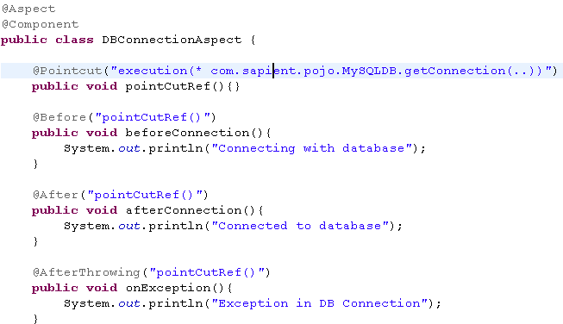
@AspectJ based AOP contd…
Alternatively we can define the point-cut at single place as follows:
Defining Point cut

Slide 21
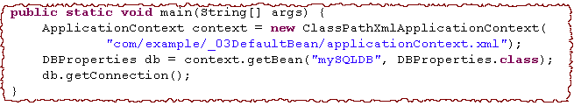
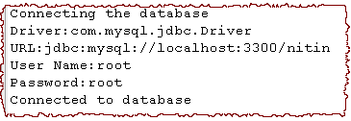
@AspectJ based AOP contd…
Step 4: Client Code and Output
Reference of root type
Method Before
Method After
Notes:
A proxy of root type is created. In the above code snippets, If you will take the reference of MySQLDB class for the mySQLDB bean, you will have a ClassCastException as proxy is created for DBProperties.

Slide 22
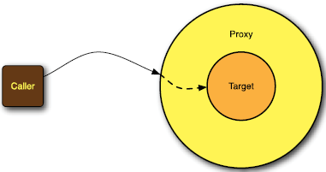
Advice Types
Defining Spring Advice
Spring aspects can work with five kinds of advice:
Before—The advice functionality takes place before the advised method is invoked
After—The advice functionality takes place after the advised method completes, regardless of the outcome.
After-returning—The advice functionality takes place after the advised method successfully completes.
After-throwing—The advice functionality takes place after the advised method throws an exception.
Around—The advice wraps the advised method, providing some functionality before and after the advised method is invoked.

Slide 23
Defining Point-cut
In Spring AOP, pointcuts are defined using AspectJ’s pointcut expression language. It can be defined either with the advice or globally.
Point-cut Expression
Trigger on a method execution
Regular Expression for class name
Any Return Type
Any Argument
“execution” in the regular expression is AspectJ pointcut designators.
Spring supports a variety of point-cut designators.

Slide 24
Defining Point-cut contd…
When applied to Spring AOP, the scope of these pointcuts will be narrowed to matching all method executions within the certain types only :
Matching all methods defined in classes inside package com.sapient.pojo
within(com.sapient.pojo.*)
Matching all methods defined in classes inside package com.sapient.pojo and classes inside all sub-packages as well
within(com.sapient.pojo..*)
Match all methods within all all implementing classes of DBProperties interface
within(DBProperties+)
Match all methods defined in beans whose name ends with ‘Properties’.
bean(*Properties)

Slide 25
Combining pointcut expressions
In AspectJ, pointcut expressions can be combined with the operators && (and), || (or), and ! (not). e.g.
For eg. to match all methods with names ending with Properties and DAO :
Use ‘&&’ sign to combine both expressions
bean(*Properties) && bean(*DAO)

Slide 26
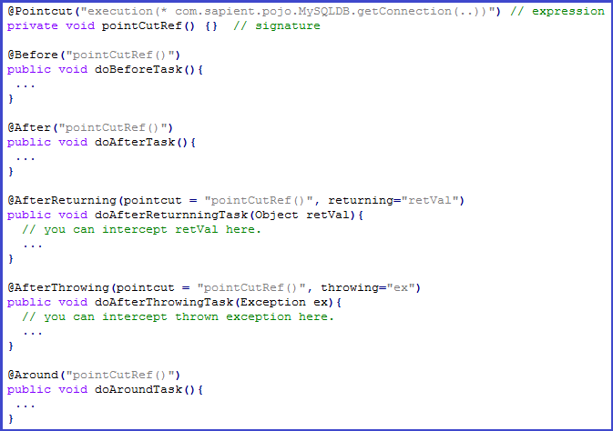
Declaring Advice
You can declare any of the five advices using @{ADVICE-NAME} annotations as given below :

Slide 27
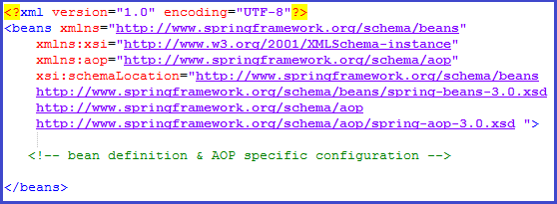
Schema-based AOP
To use the aop namespace tags described in this section, you need to import the spring-aop schema as described below:
You will also need following AspectJ libraries on the CLASSPATH of your application. These libraries are available in the 'lib' directory of an AspectJ installation, otherwise you can download them from the internet :
aspectjrt.jar
aspectjweaver.jar
aspectj.jar
aopalliance.jar

Slide 28
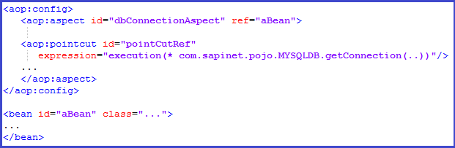

Schema-based AOP contd…
Declaring an aspect
An aspect is declared using the <aop:aspect> element, and the backing bean is referenced using the ref attribute as follows:
Declaring a pointcut
While working with XML Schema based configuration, pointcut will be defined as follows:

Slide 29
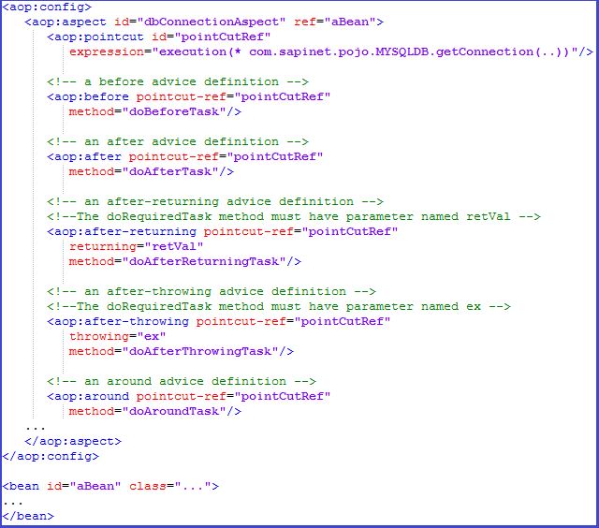
Schema-based AOP contd…
Declaring advices
You can declare any of the five advices inside an <aop:aspect> using the <aop:{ADVICE NAME}> element as given below:

Slide 30
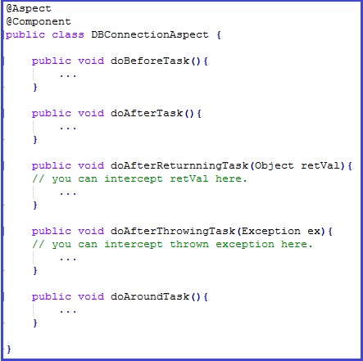
Schema-based AOP contd…
Following is the aspect – DBConnectionAspect :

Slide 31
Transaction Management using AOP
Transaction management is critical in any form of applications that will interact with the database. The application has to ensure that the data is consistent and the integrity of the data is maintained.
AOP programming enables the concerns that cross-cut over the application can be separated and can be encapsulated.
Since marking the beginning of a transaction, end of a transaction, commiting the database in the case of successful operation and making a rollback for failure operations are really cross-cutting concerns, it is ideal to take AOP based approach for this scenario.
Consider a Student Management system as the use case where we would be implementing transactions through AOP. The files are :
StudentRegistrationService.java : Registers a new Student
Main.java : Main Application
StudentUtils.java : Utility methods to get new studentId & add new student details to DB
Beans.xml : defines beans related to transaction management :
studentRegistrationProxyService : It is an instance of is an instance of ProxyFactoryBean. The target for this proxy will be the Student Registration Service object which is specified through ‘target’ property.
studentTransactionInterceptor : It intercepts the transaction related operations through the element ‘interceptorNames’. It defines the transaction attributes. For eg. In this case transaction attribute “Propogation” is set to “Required”.

Slide 32
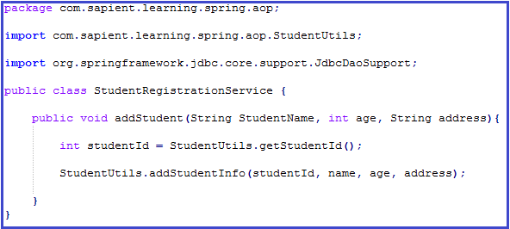
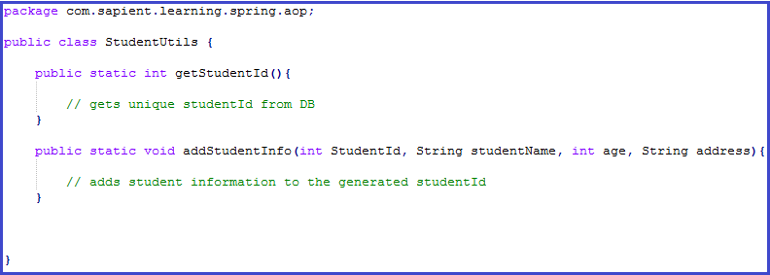
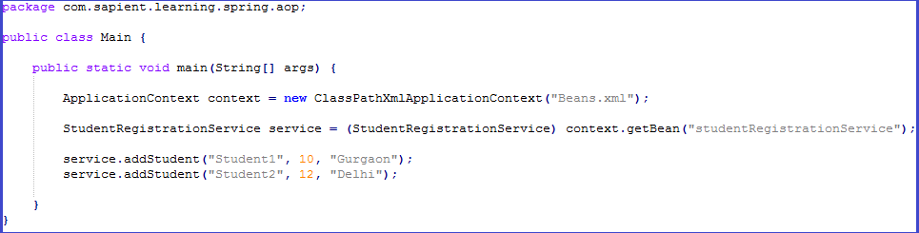
Transaction Management using AOP contd…
StudentRegistrationService.java
StudentUtils.java
StudentUtils.java
Main.java
Main.java

Slide 33
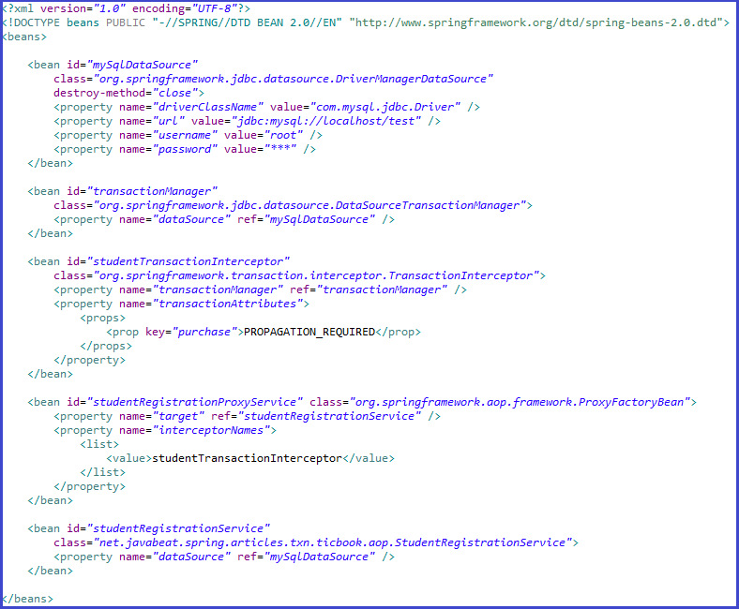
Transaction Management using AOP contd…
Beans.xml
Beans.xml

Slide 34
Limitations of Spring AOP
Beans.xml
A little difficult to debug the AOP based application code since the business classes are advised behind the scene with aspects.
Since it uses proxy based AOP, only method level advising is supported, doesn’t support field level interception so your join-point can be at method level not at field level in a class.
Only methods with public visibility will be advised, methods with protected, private or default visibility will not be advised.
Aspects cannot advise other Aspects - Not possible to have aspects to be the target of advice from other aspects.
Local or internal method calls within an advised class doesn’t get intercepted by proxy, so advise method of the aspect does not get fired/invoked

Slide 35
Solution to Spring AOP limitations
Beans.xml
The AOP proxy can’t intercept a call made from one method to another on the same target object (typically a service bean), even though both methods are supposed to be wrapped by the proxy.
One obvious solution to the problem is to always explicitly get the bean reference from the Spring context and then call the method on it, instead of calling the method on ‘this’.
It’s an easy solution, but one that doesn’t come without a few nuisances. For instance, it adds to your service bean some compile-time dependencies on Spring classes that wouldn’t have been necessary otherwise.
One less intrusive solution I’ve come up with is a AdviceSkippingInjector.java that injects the reference to any proxied Spring bean into a property on the “raw” bean, i.e., the object prior to being wrapped in the proxy.
To explore this solution more consult the following link :
http://www.digizenstudio.com/blog/2007/05/29/the-self-calling-limitation-in-spring-aop-and-one-unintrusive-solution/

Slide 36
Exercises
Create an Order POJO which will have OrderId, Order Type (ENUM), Side, Client Id, Order Quantity, Order Price, Symbol.
Create an OrderService which will have few functionality like
Create and Send Buy Order
Create and Send Sell Order
Handle Executed Orders
Please use AOP to enable logging in the different methods.
Cover all aspects & use AOP to find out timing for each function.

Slide 37
Recap
Understanding need for AOP
AOP implementation in Spring
AOP terminologies
@AspectJ based AOP
Schema based AOP
Transaction management using AOP

Slide 38
References
docs.spring.io/spring/docs/current/spring-framework-reference/html/aop.html
www.tutorialspoint.com/spring/aop_with_spring.htm
www.javatpoint.com/spring-aop-tutorial
www.journaldev.com › Spring
https://www.mkyong.com/spring/spring-aop-examples-advice/
https://www.mkyong.com/spring3/spring-aop-aspectj-annotation-example/
howtodoinjava.com › Spring › Spring AOP

Slide 39
THANK YOU

